Slide 1
Chapter 3
Finding out about users
and the domain

Slide 2
Introduction
We must understand the users and what they do (the domain)
Focus on primary users, not secondary ones
  Key concept in user-centered design
  These are the people who we will observe, interview or survey
Domain analysis is always important in requirements gathering
  Many techniques come from software engineering

Slide 3
User Characteristics
Types of characteristics
  Demographic: age, gender/sex, culture
  Physical capacity: esp. disabilities
  Knowledge: education, computer experience
  Psychological: attitude, motivation
Descriptions of characteristics may be vague
Easier to design for a small group with a narrow set of characteristics
  Diverse groups have conflicting needs

Slide 4
Physical Disabilities
More important than might be obvious
  Disabilities are common
    15-35% of all people have a disability
      Though less than this number are working
    5% of all men are colorblind to some degree
  Legal and professional standards require accommodation
    Laws like Americans with Disabilities Act (ADA)
    Standards like the Web Accessibility Initiative

Slide 5
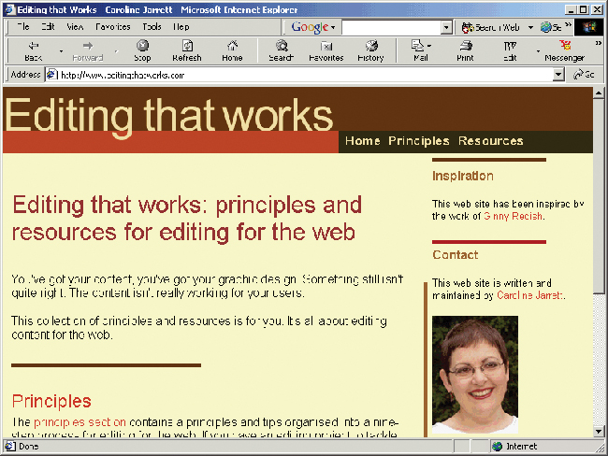
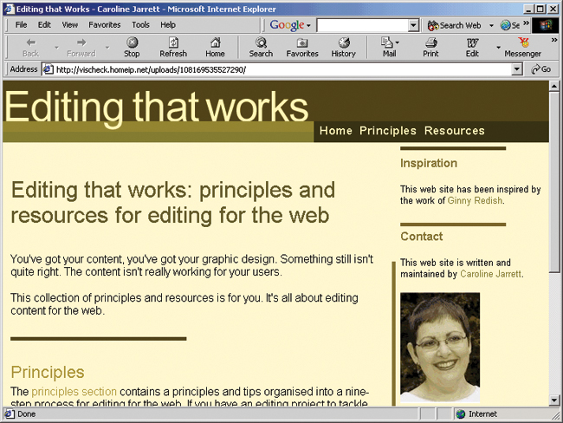
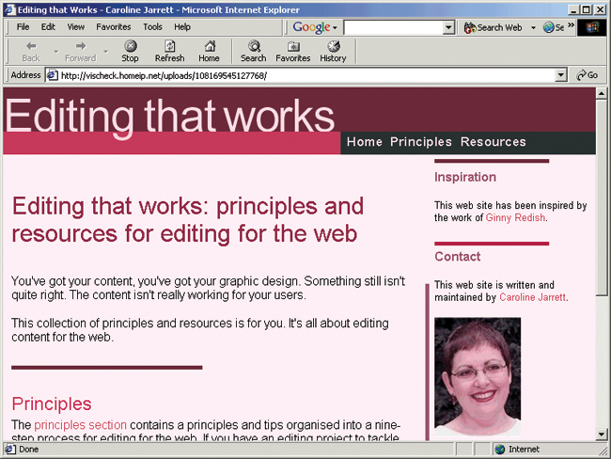
Colorblindness
Original
Red-Green
Blue-Yellow

Slide 6
Exercise for 9/22 Lecture
Who uses PAWS?
What are the characteristics of PAWS users?

Slide 7
Personas
Persona: a virtual person who embodies characteristics and interests of a particular user group
A tool for thinking about users
  Allow designers to think and talk about people with names
    Easier to remember
    Exploits stereotypes in a positive way
Should be based on real information
Can include personas for non-users

Slide 8
Persona Example
Nate the skateboarding student
  Well-educated and smart but not studious
  Very comfortable with computers
    Knows lots about using them
    But lacks formal knowledge
  Not patient
  Does not like conforming to convention

Slide 9
Stakeholders
Primary stakeholders
  Actual users of system
Secondary stakeholders
  People who are interested in the system for some reason, but who will not use it
  Managers, designers, customers, developers
You must satisfy some of the secondary stakeholders, but the system’s success depends on the primary ones

Slide 10
User Needs
Expressed: what people say they want
  Very important: system must address these
  But users may not know what is possible
Felt: real needs that people can’t express
  Designers must tease out these needs during requirements gathering
  Meeting a felt need can be very beneficial
Normative: what experts say is needed
  Experts may be right, but they may be conventional

Slide 11
Domain Analysis
Domain: area of expertise or knowledge relevant to the application
Domain analysis: process of learning about the domain
  Critical for making an effective application
  Application must model domain correctly
Key technique: interviewing domain experts
  Users, users’ supervisor, support staff, trainers …
  Different experts may have different strengths

Slide 12
Potential Challenges
Some domain experts don’t know how to describe what they do
  Not articulate enough
  Expertise is too automatic
  May have overly complex models of what they do
Experts may not want to cooperate
  Especially if automation threatens their job

Slide 13
Domain Modeling
Domains can be modeled formally
  UML (Universal Modeling Language)
  Entity-relationship diagrams
  Dataflow diagrams
  Concept Maps
Textbook recommends content maps
  Flexible and simple
  Less focus on data structures and complicated graphic notation
  More focus on natural human communication

Slide 14
Domains are static
In general, domains do not change quickly
So, domain modeling is not less concerned with what people do than task analysis
  The next chapter looks at task analysis

